Slide 1
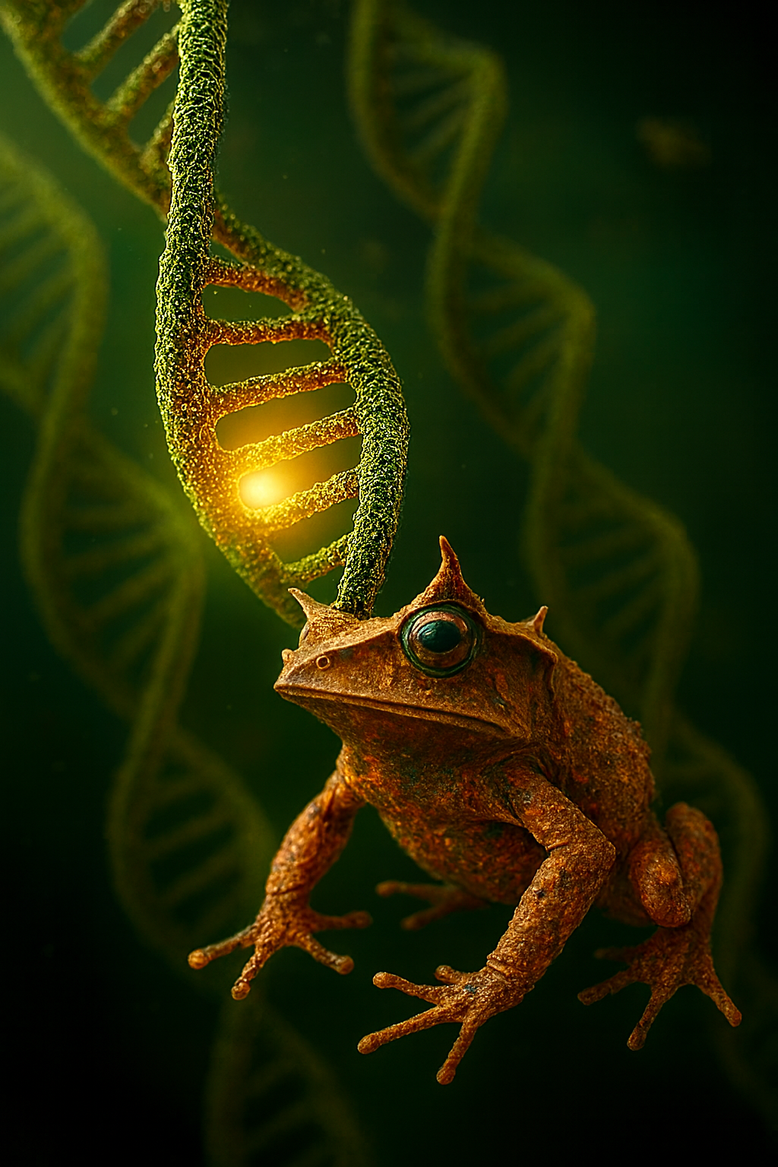

ALMA MATER STUDIORUM
UNIVERSITA’ DI BOLOGNA
De novo genome assembly
and functional genomics of the Pelobatrachus nasutus
as a phenotypic plasticity, and antimicrobial defenses model
Marco Cuscunà

Slide 2
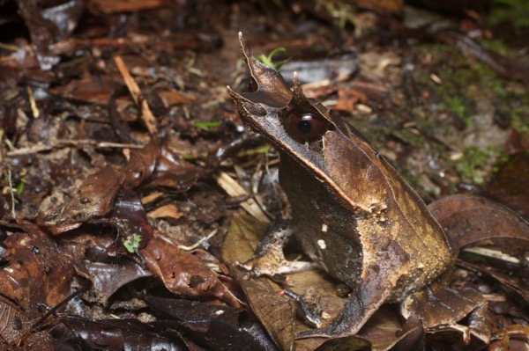
Background knowledge
It is a Southeast Asian amphibian known for its striking leaf like camouflage, with the eyelid projection and a characteristic textured skin.
This species exhibits notable phenotypic plasticity and produces Antimicrobial Peptides (AMPs) interesting for biomedical purposes.
Pelobatrachus Nasutus in his habitat [1].
1. Image source: http://www.wildherps.com/species/M.nasuta.html.

Slide 3
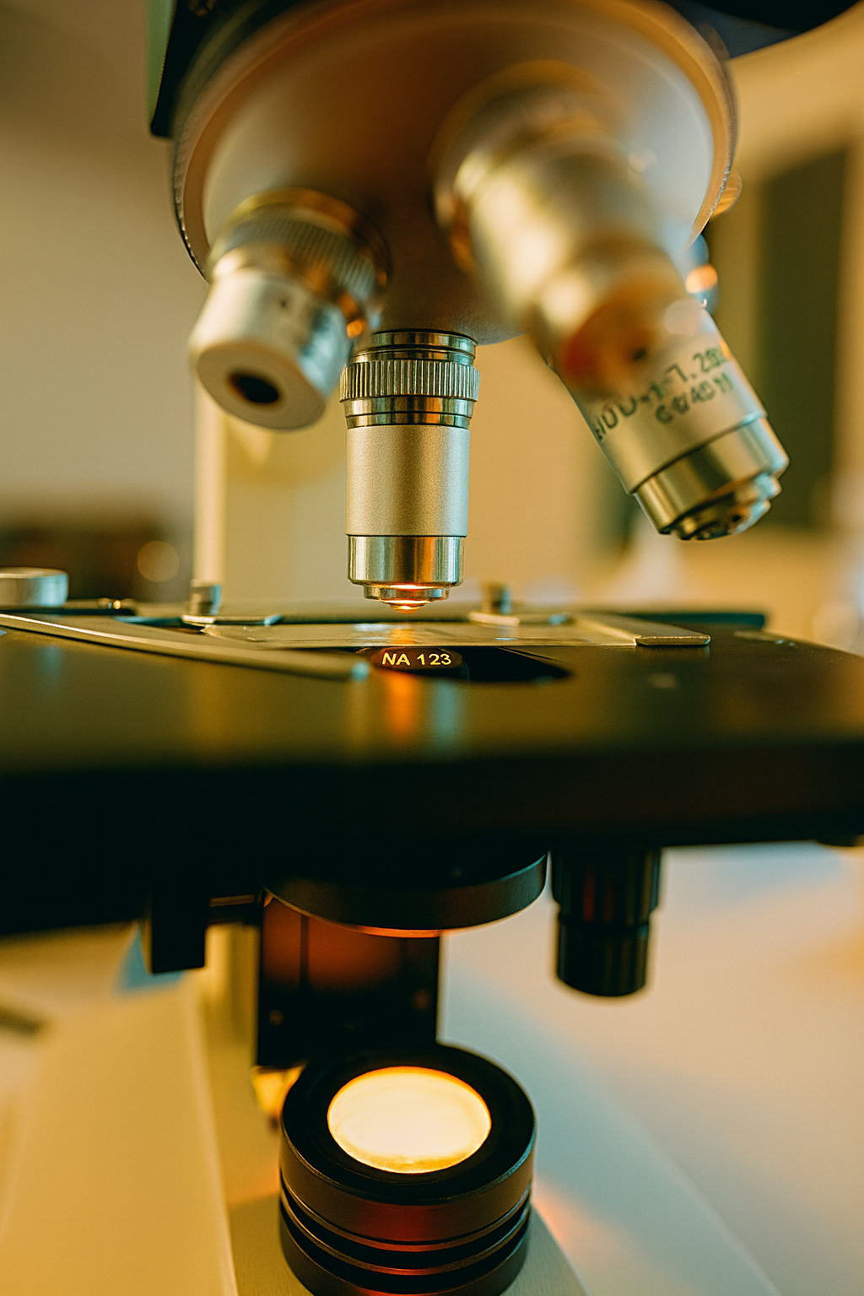
What is
the aim of the study?
Generate the first and annotated reference genome of Pelobatrachus nasutus, highlightning potential SNPs involved in differences between different habitats (focusing on genes involved in morphological variations, and AMPs production).

Slide 4
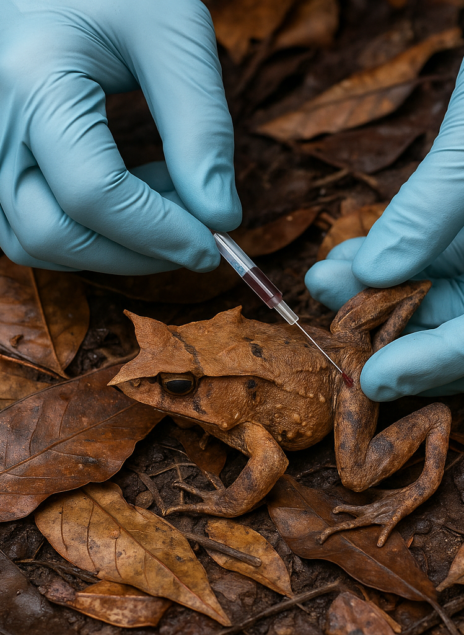
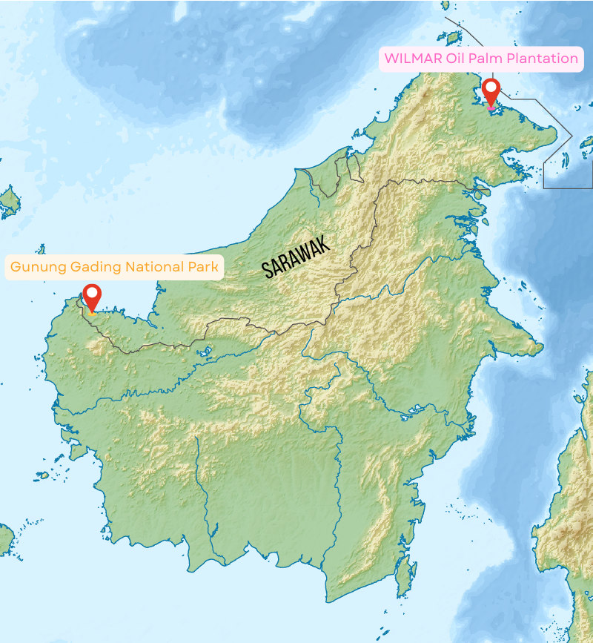
Sampling sites in Sarawak, Malaysian Borneo: Gunung Gading National Park (protected forest) and Wilmar Oil Palm Plantation (fragmented habitat) [3].
Sample Collection
Reference Genome samples
Samples were collected from blood to obtain High Molecular Weight (HMW) DNA, and from tissue biopsies to perform RNA-seq for gene annotation.
Population genomics
Samples were collected from 10 individuals: 5 from Gunung Gading National Park and 5 from the WILMAR Oil Palm Plantation. RNA was extracted to enable population-level differential analysis.
Rapresentative image of Pelobatrachus Nasutus’ blood sample extraction, for illustrative purposes only [2].
2. Image source: https://www.canva.com/ai-image-generator/
3. Edited from: https://commons.wikimedia.org/wiki/File:Relief_Map_of_Borneo.png

Slide 5

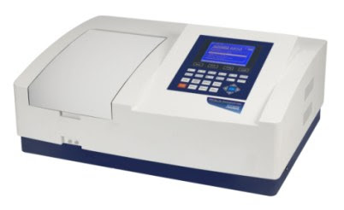
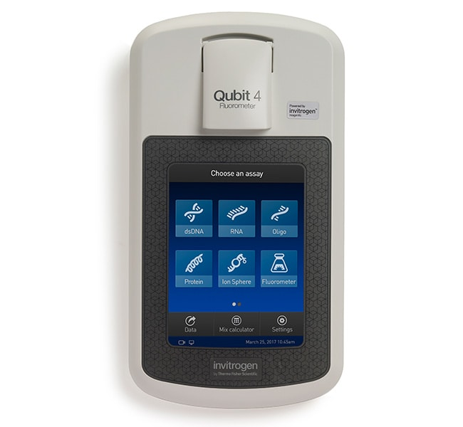
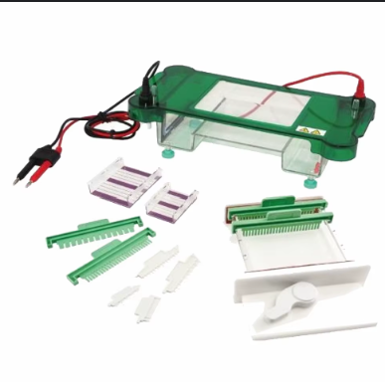
RNA/DNA extraction
Qiagen Genomic-tip was used to extract DNA, while Qiagen Rneasy kit to perform RNA extraction.
Qubit fluorometer, was used to make accurate quantification of double-stranded DNA, and spectrophotometer with electrophoresis to evaluate purity and sizes of the fragments.

Slide 6

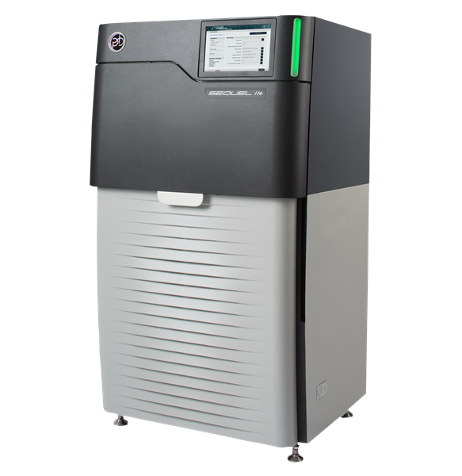
Reference Genome Sequencing
Sequencing was performed with PacBio HiFi platform which provided highly accurate reads (with a quality value >30 and coverage of 30-40x).
Rapresentative image of PacBio Sequel IIe Hi-Fi System, for illustrative purposes only [4].
4. Image source: https://www.globenewswire.com/NewsRoom/AttachmentNg/ec7721b6-506f-416d-a80b-2837542bdb85/en

Slide 7

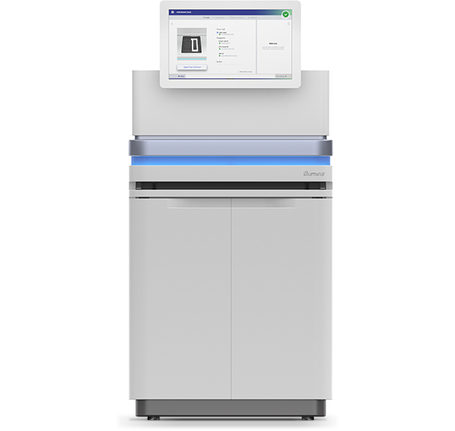
Contig Assembly and scaffolding
hifiasm
To assembly the reads was used hifiasm an assembler specifically optimized for PacBio HiFi data.
Illumina NovaSeq sequencing
To achieve chromosome level genome, Hi-C libraries were prepared from fresh tissue DNA sequenced with Illumina system.
3D-DNA and Juicebox
Hi-C contact maps libraries are used in combination with 3D-DNA and Juicebox for scaffolding.
Assembly quality
Assessed using BUSCO, QV and N50.
Rapresentative image of Illumina NovaSeq PE150 System, for illustrative purposes only [5].
5. Image source: https://emea.illumina.com/content/dam/illumina-marketing/includes/platform-comparison.html

Slide 8
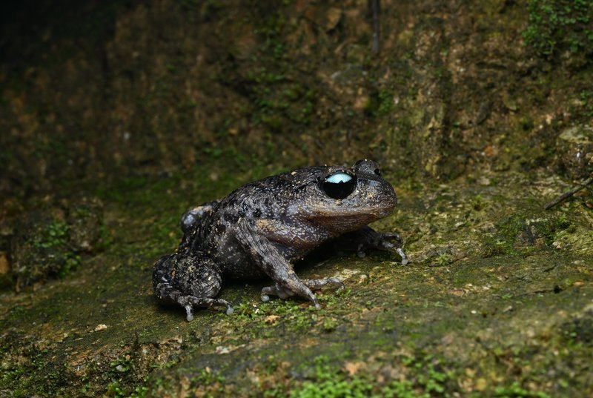

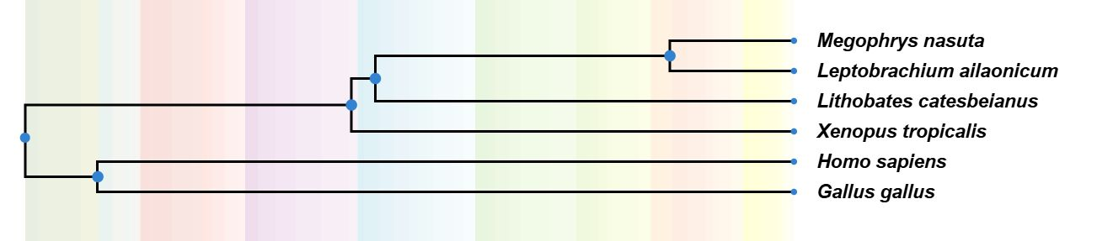
RepeatModeler2 and RepeatMasker
Functional annotation
RepeatModeler2 is used to identify de novo repeated elements and RepeatMasker to mask them preventing spurious gene predictions.
RNA-sequencing and STAR
Was performed RNA-seq on tissue skin samples of the reference individual, and reads were mapped through STAR against the assembled genome.
BRAKER2
Gene prediction was done following BRAKER2 pipeline, combining RNA-seq evidences with AUGUSTUS ab initio models.
Leptobrachium Ailaonicum in his habitat [6]
MAKER
To refine it, was used MAKER pipeline to integrate these results with homology from related Leptobrachium Ailaonicum genome already studied.
TimeTree-based phylogeny showing the evolutionary placement of Pelobatrachus (Megophrys) nasutus relative to the closely related Leptobrachium ailaonicum
6. Image edited from: https://amphibiaweb.org/cgi/amphib_query?where-genus=Leptobrachium&where-species=ailaonicum

Slide 9
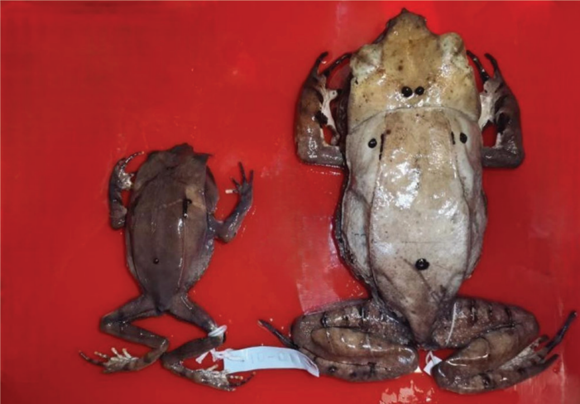
Population analysis
BWA-MEM2
Reads from the genome of the 10 individuals coming from the two habitats, were sequenced with Illumina NovaSeq and mapped against the reference genome through BWA-MEM2.
GATK (Genome Analysis Toolkit)
Variant calling was performed GATK that reconstruited the local haplotypes, output SNP and indel calls.
Address medium coverage genotypes
To address this population genetic analysis was based on genotype likelihoods rather than hard genotype calls.
Comparison of esemplars of Pelobatrachus Nasutus, one coming from protected environment (on the right) and the other one from fragmented environment (on the left)[7].
PCA, Fst and BayPass
PCA and Fst are used to assess the presence of a significative differences between the two population. While BayPass detected correlations between allele frequencies and ecological variables.
7. Image source: doi.org/10.46754/jssm.2025.02.013

Slide 10
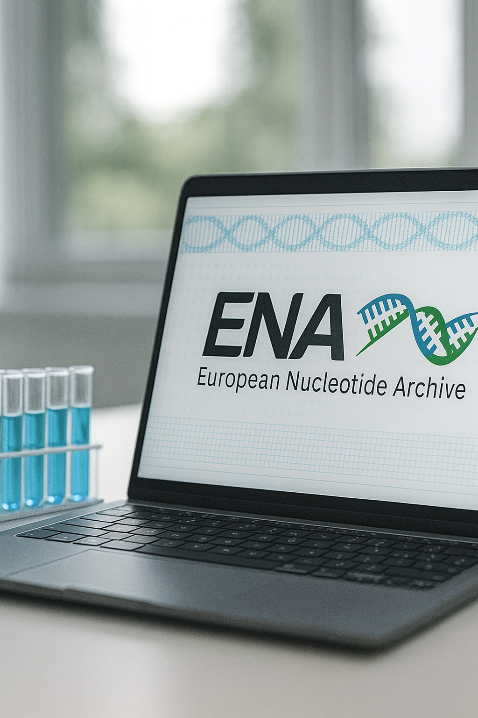
Expected Results
And Data Submission
High-quality and annotated reference genome
Detection of genes potentially related to skin adaptation highlighting the phenotypic plasticity
Annotation of genes potentially involved in production of AMPs for biomedical purposes
All data at the end of the experiment will be submitted in ENA (European nucleotide archive) to ensure reproducibility and reuse by the scientific community.

Slide 11
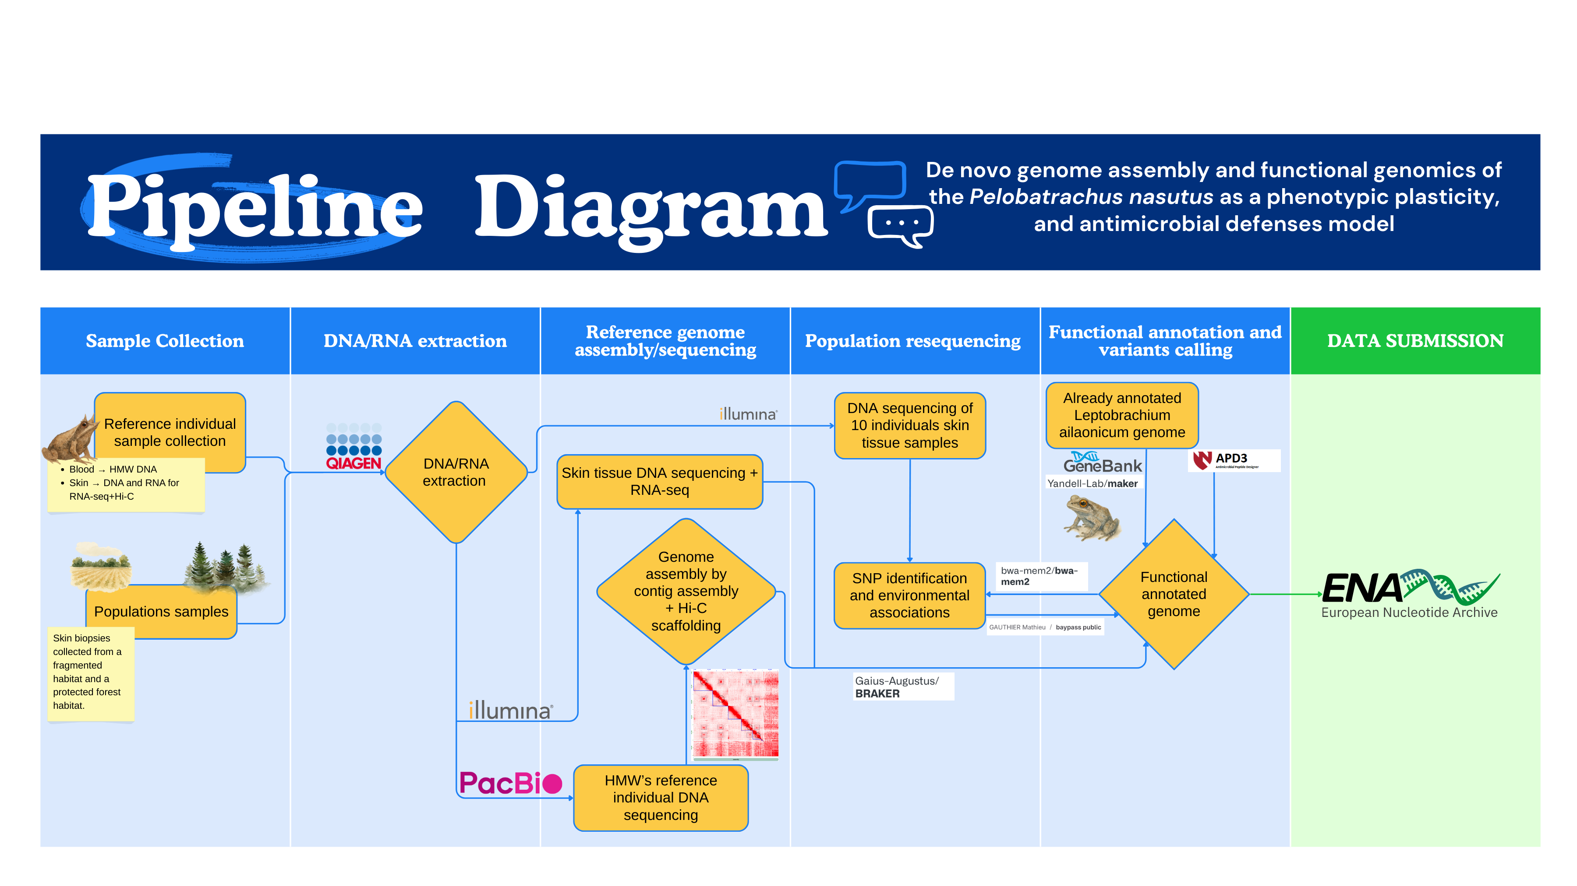


Slide 12

Estimated costs
Budget: $100.000

